Slide 1
Caesar Cipher
Martzel Baste

Slide 2
Definition
is a substitution cipher, named after Julius Caesar.
Operation principle:
each letter is translated into the letter a fixed number of positions after it in the alphabet table.
the fixed number of positions is a key both for encryption and decryption.

Slide 3
Operation principle
K=3
Outer: plaintext
Inner: ciphertext

Slide 4
Usage
The Caesar cipher is still useful to prevent people from unintentionally reading something.
ROT-13
By decrypting, the user agrees that they want to view the content.
Fundamental problem: key length is shorter than the message.
Let P = C = K = Z₂₆
∀x∈P, ∀y∈C, ∀K∈K, define
y =e_{K}(x) = x + K (mod 26)
and
X=d_{K}(y) = y - K (mod 26)

Slide 5

Example
K=4
Plaintext letter : ABCDEF...UVWXYZ
Ciphertext letter : EFGHIJ...YZABCD
Hence
MARTZEL BASTE
is translated into
QEVXDIP FEWXI

Slide 6
Breaking the Caesar cipher
by trial-and error
by using statistics on letters
frequency distributions of letters
letter percent
A 7.49%
B 1.29%
C 3.54%
D 3.62%
E 14.00%
..................................

Slide 7
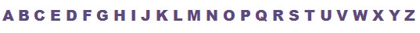










Encryption And Decryption (Simple Shift)

Slide 8
Encryption And Decryption (Mathematical)
0 | 1 | 2 | 3 | 4 | 5 | 6 | 7 | 8 | 9 | 10 | 11 | 12 | 13 | 14 | 15 | 16 | 17 | 18 | 19 | 20 | 21 | 22 | 23 | 24 | 25
M every letter in the message.
X number order of each letter in the alphabet from 0 to 25.
K the key-value
Y the number result upon adding X and K
Convert the letter M into the number X that matches its order in the alphabet starting from 0 to 25.
Calculate: Y = (X + K) mod 26
Convert the number Y into a letter M that matches its order in the alphabet starting from 0 to 25.

Slide 9

Encryption And Decryption (Mathematical)
0 | 1 | 2 | 3 | 4 | 5 | 6 | 7 | 8 | 9 | 10 | 11 | 12 | 13 | 14 | 15 | 16 | 17 | 18 | 19 | 20 | 21 | 22 | 23 | 24 | 25
Convert the letter M into the number X that matches its order in the alphabet starting from 0 to 25.
Calculate: Y = (X + K) mod 26
Convert the number Y into a letter M that matches its order in the alphabet starting from 0 to 25.

Slide 10

Decryption (Modular Math)
0 | 1 | 2 | 3 | 4 | 5 | 6 | 7 | 8 | 9 | 10 | 11 | 12 | 13 | 14 | 15 | 16 | 17 | 18 | 19 | 20 | 21 | 22 | 23 | 24 | 25
Let C every letter in the ciphertext. Convert the letter C into the number X that matches its order in the alphabet starting from 0 to 25.
Calculate: Y = (X - K) mod 26
Convert the number Y into a letter C that matches its order in the alphabet starting from 0 to 25.

Slide 11
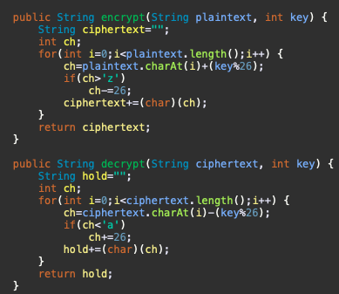
Sample Program

